Slide 1
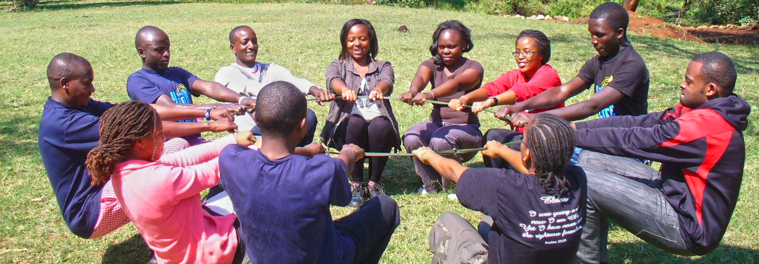
CHANGING SOCIAL NORMS, BUILDING COALITIONS

Slide 2
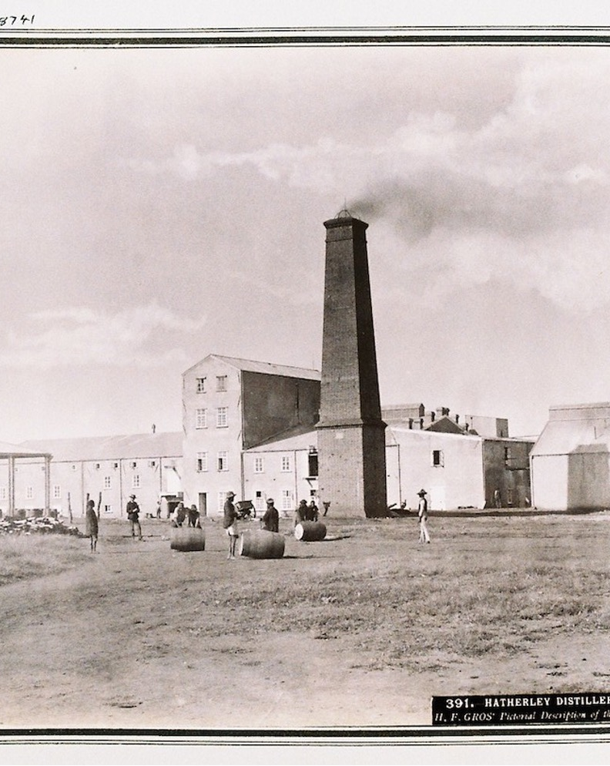
IT IS CULTURAL
… but is it?
Very first factory in Africa
The Liquor Machine
The lifeblood of European colonization
Notes:
Mark Lawrence Schrad’s (professor at Villanova University) book of the very first FACTORY in Africa - an alcohol distillery. Colonizers used alcohol to oppress Africans. And African leaders, like those from (modern day) Botswana wanted to protect their people from alcohol and the liquor machine.
Booze was the lifeblood of European colonization
Hard liquor – a perfect tool of exploitation. Making you indispensable. You get fur, ivory, minerals, land, people
The first distillery on the continent of Africa – Hatherley distillery – white mine owners needed black labor

Slide 3
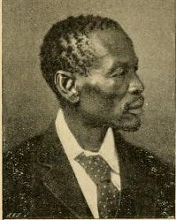
BOTSWANA WOULD NOT EXIST
Prohibition was sovereignity
Bamangwato King Khama III
Bechuanalad
1873
Notes:
King of Botswana – Bechuanaland – 19
Bamangwato king Khama III
1873
Prohibition was sovereignity
Without their temperance Botswana would not exist

Slide 4
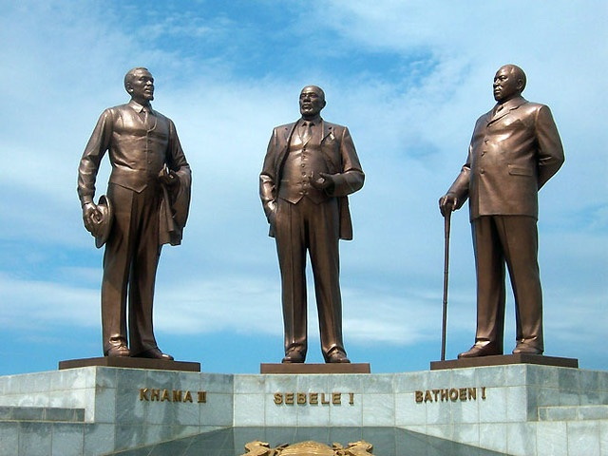

Slide 5

IT IS NOT CULTURAL
White-people centrism
Buddhism, Islam
Native people in US
Africa before colonization
Africa now
Different strength, less occassions
Notes:
Buddhism, Islam, Africa before colonisation, the Native people in the US - these are all cultures/ religions/ large groups of human beings where the norm is alcohol abstention. So, to say “human civilisation has always had alcohol” is white-people centric, it’s wrong, and it applies today’s standards to historic circumstances. When people had alcohol in history, they did not have high strength wine, beer, and liquor.

Slide 6

EXPLOITATION OF DREAMS
Notes:
Big Alcohol’s increasing impact - and I saw some stories from UAPC about the predatory practices of alcohol companies in Uganda. We can call it Big Alcohol or the Liquor Machine. The goals is still the same: exploitation of the youth, development, and potential of Ugandans and Africans in general; extracting the wealth from Uganda and Africa into the pickets and off-shore bank accounts of industry executive and shareholders.
You could also show the slide with the dubious five - to illustrate how the industry shapes our values, communities, institutions and policy processes, our health and so on…
Dennis Onyango

Slide 7


BIG ALCOHOL EXPOSED
LOBBYING
Eliminate any alcohol policy effort threatening sales ,profits
PROMOTION
Drive alcohol availability (4 dimensions), alcohol norm
SABOTAGE
Avoid, violate, undermine society's laws, institutions
MANIPULATION
Control, protect, cultivate its image (brand value)
DECEPTION
Hinder public recognition of the real effects of alcohol
Notes:
the dubious five - to illustrate how the industry shapes our values, communities, institutions and policy processes, our health and so on…
Lobbying – delay, derail, divide, destroy
Manipulation – CSR, Green-washing (sustainability, water), Pink-washing (gender equality/ feminism, cancer prevention/ research
Deception - Own research, funding research in health– informing policy, question objective research, doubts
"Responsible drinking" as concept

Slide 8
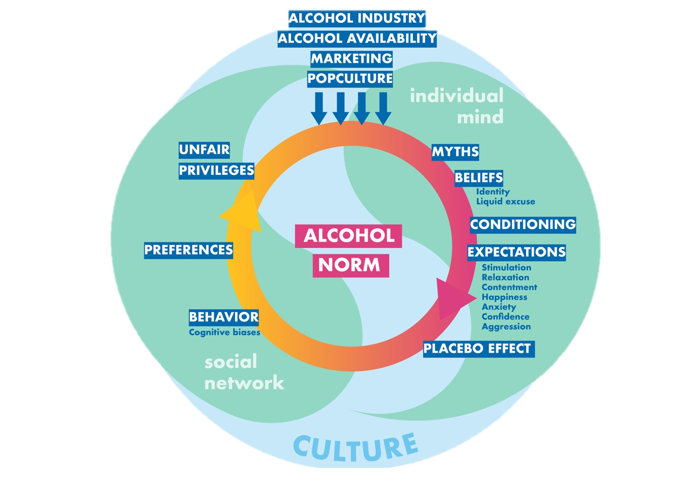
ALCOHOL NORM
Shaped by the industry
Made women drink wine
Make cultures of abstainers believe they must use alcohol
Everyone likes and wants it all the time
Not even alcohol users want alcohol all the time
Notes:
alcohol norm - explaining that we all have ideas, myths, expectancies about alcohol in our mind and in our communities and that they are shaped by the alcohol industry. They made women in the U.S. consume wine, when virtually no women were consuming alcohol in general and wine in particular. And they are working to convince Ugandans that they all must have alcohol - when most Ugandans still live alcohol-free. So the industry works with pushing alcohol, making it look like everyone likes and wants to use it. In truth not even most alcohol users actually want to have alcohol all the time everywhere.

Slide 9

SOCIAL NORMING
Notes:
Social Norming” that Big Alcohol wants to make it look like everyone likes and wants alcohol - and that we need to make sure we do not help them in this social norming, that we employ social norming that benefits health and development for all.

Slide 10
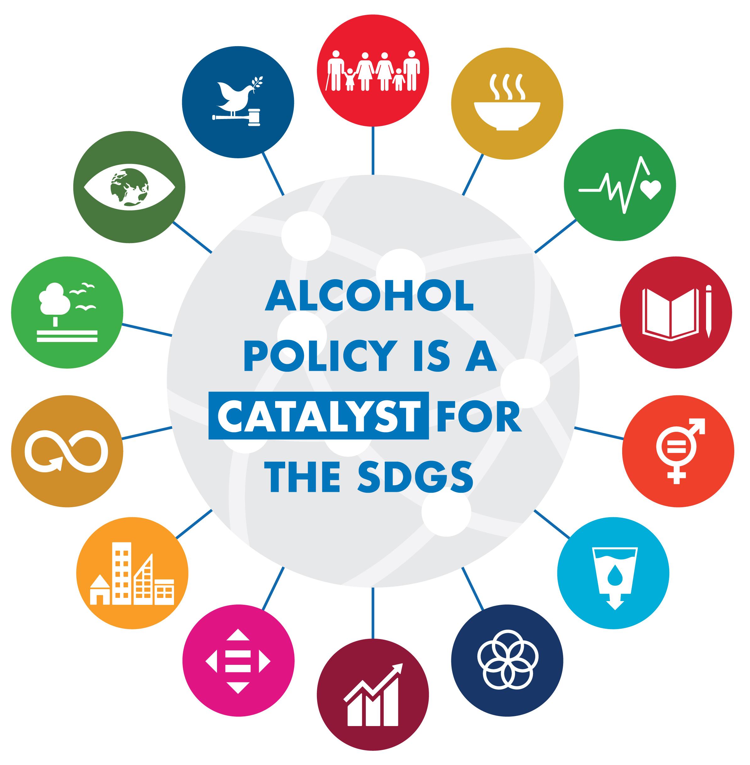
ALCOHOL POLICY
POTENTIAL
#ALCPOLPRIO
Transforming environments
Transforming norms
Protecting people against predatory practices of alcohol companies
Boosting health system/ UHC
Catalyzing sustainable development
Generating additional resources
Notes:
That’s the potential of Alcohol Policy; that’s why we speak about alcohol policy as catalyst for sustainable development - it promotes human potential on the individual level, it strengthens communities, it boosts economies, it drives social development, equality, prosperity.

Slide 11

THE POWER OF COALITIONS
Sweden, Norway
Kenya, Sri Lanka, Thailand, Lithuania
Uganda?
Notes:
When the topic is framed differently, new partnerships are created. you could then speak about that alcohol policy successes are most of the time driven by strong community efforts (maybe not in Russia and the Philippines): Kenya, Sri Lanka, Thailand, Lithuania, definitely Sweden, Norway 100 years ago, and Uganda today. That’s why the WHO GAS cover “community action” too

Slide 12

STRENGTH OF COALITIONS
Leading with values
Coalitions drive change
Movements ensure holistic health promotion on all levels
Mainstreaming
Policy can sustain coalitions
Notes:
1. alcohol excise tax is single most cost-effective catalyst for health promotion
1. earmarking
2. health promotion needs coalitions that lead with values
3. local and national coalitions help drive policy change/ adoption
4. policy adoption helps sustain coalitions, build movements
5. movements promote health health (environments, behavior, literacy, CDoH counter-action) on all levels (beyond single risk factors)
6. Mainstreaming facilitates policy adoption (coalitions help to mainstream as there are different actors in the coaltions that see the benefits of the same solution but in different areas of life – police, mental health, women organisations, child rights organisations etc)
7. need for global coalition (infrastructure) to support local/ national coalitions

Slide 13

Academia
Evidence
General
public
Decision makers
CSOs
Addiction industry
Notes:
Connect
Transmit signals
Action

Slide 14
Geneva
Capitals
Nationalmembers
Movendi
Movenment
(New York)
Notes:
Connect
Transmit signals
Action

Slide 15

ADDED VALUE OF (CSO) PARTNERSHIPS
#DEVELOPMENTFORALL
Bridge and/ or fill gaps
Build trust
Help translate between different actors
Coverage and outreach
(Technical) expertise
Capacity beyond individuals
Achieve more with less
Resilience, persistence, longevity

Slide 16
BUILD, STRENGTHEN & HARNESS NETWORKS
Convene right people
Clarify purposes
Coordinate action(s)
Trust,
not control
Network
principles
Node,
not hub
Humility,
not brand
Mission,
not organisation
Collaborate generously
Cultivate trust
Adapted from Dr. Thaksaphon (Mek) Thamarangsi

Slide 17

THE BIG HOW
Purpose driven partnerships
Co-creation of knowledge, theory of change, and strategic action
Develop and strengthen capacity
Harness diversity of knowledge, expertise, experience
Address lack of common knowledge and understanding
Learn and adapt (internally and externally)
Clarity on roles and responsibilities: transparency, democracy
Focus on substance, competence, excellence for leadership and programming
Regular communication and coordination
Timeliness

Slide 18

TACKLING SILO MENTALITY
#DEVELOPMENTFORALL
SOIL
Joint actions and learning on the ground
OILS
Facilitate smooth participation across sectors
SOLI(darity)
Shared language and trust
Adapted from Dr. Thaksaphon Thamarangsi

Slide 19
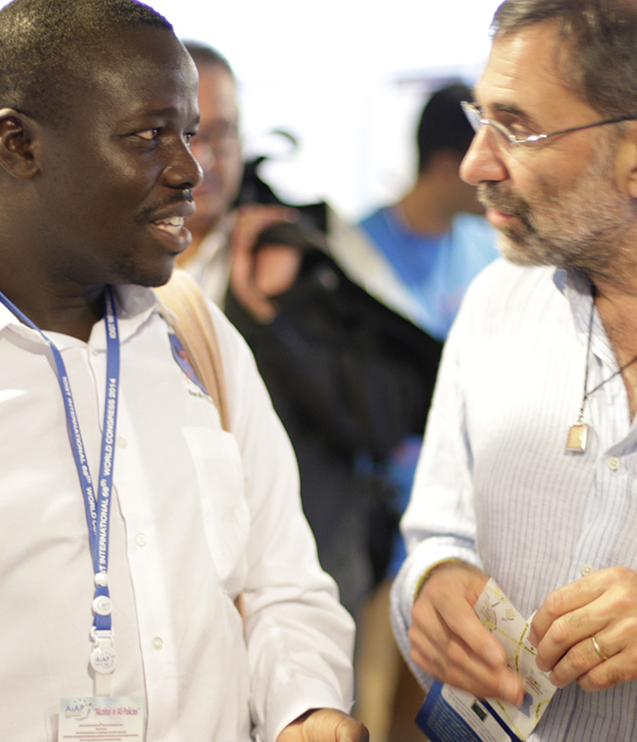
CONCRETE ACTIONS
Deglamorizing
Reduce unfair privileges
Social norming
Understanding the real harm
Counteract the forces that promote alcohol
Expose industry strategies
Formulation and implementation of effective policies
Integrate prevention of alcohol into daily life

Slide 20

THANK YOU
Development through alcohol prevention
www.movendi.ngo
kristina.sperkova@movendi.ngo

